Slide 1
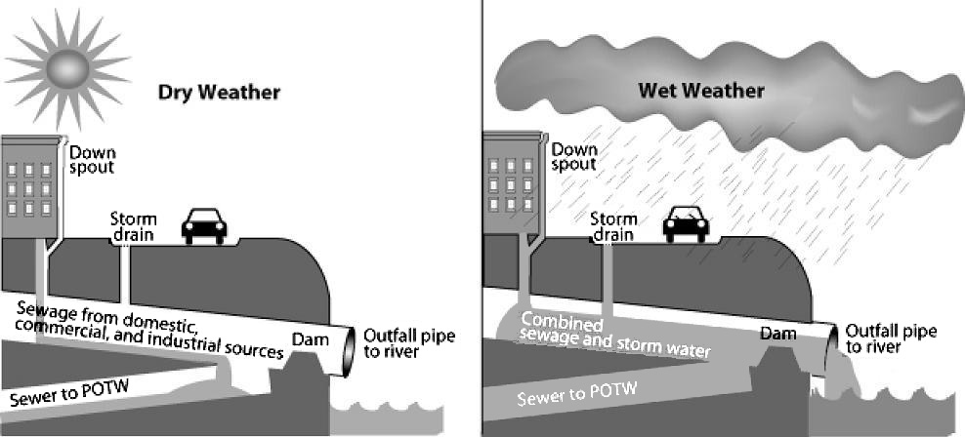
Your City & It’s Permit Requirements
Overview
New Jersey communities and sewage treatment plants with combined sewer overflows (CSOs) have new permits with a series of new requirements. New Jersey communities can learn from hundreds of others nationwide that have already taken major steps toward ending combined sewer overflows. The state Department of Environmental Protection (NJDEP) has designed this permit to allow communities a lot of flexibility in choosing what works for them. This fact-sheet is intended to explain why this permit is different and what new actions are required.
What does the new permit require?
New Jersey’s new CSO permits are intended to meet the requirements of the federal Clean Water Act and the national CSO Policy by reducing or eliminating the state’s remaining 217 CSO outfalls. The permit has two major components. The first part is continuing work on Nine Minimum Controls, which communities already have been required to do. The second part is following the steps toward developing a Long Term Control Plan (LTCP). (The permits themselves, and a host of explanatory and supporting information, can be found on the NJDEP website: http://www.nj.gov/dep/dwq/cso.htm.)
About the Long Term Control Plan
The Long Term Control Plan that CSO permit holders must develop will evaluate a range of alternatives to address CSOs. Public input and cost-effectiveness of the alternatives are two of the many factors permit holders will use to decide which alternatives to implement. . Permit-holders must take several major steps toward developing a comprehensive plan for their sewer system including the following:
Develop a detailed understanding, also known as a characterization, of the sewer system.
Model how rain and snow melt affect the flows and overflows.
Identify potential solutions that would reduce or stop overflows. These include gray infrastructure and green infrastructure.
Engage residents, community groups, and business owners about what solutions they suggest and support.
Evaluate which options will have the most impact at the lowest cost. This can include considering the additional benefits that certain options, such as green infrastructure, may have on the overall community.
Select the options that work best and incorporate them into the long-term control plan, which includes a timeline for construction.
Implement the plan over coming years.
Verify, after construction, that the new controls are working as planned.
By not following the schedule in their permit, communities and utilities run the risk of government enforcement action or a third-party lawsuit, which could result in the loss of flexibility regarding CSO solutions and the timeline for implementing them.
This is how a combined sewer system works when it’s dry and when it’s raining or snowing. Graphic courtesy of U.S. Environmental Protection Agency.
What is a Combined Sewer Overflow?
Combined sewer systems, which carry both sewage and stormwater, were considered cutting-edge technology when they were built in the late 1800s and early 1900s. But when it rains, the stormwater can overwhelm the capacity of the combined sewer system. The systems have release valves of sorts – outfalls where the combined sewage and stormwater mix spills out and into waterways. When this occurs, it is called a combined sewer overflow. These types of systems are an expensive and complicated problem for communities around the country. In New Jersey, 21 communities have CSOs.
What has already been done?
Communities and wastewater treatment plants throughout New Jersey already have taken steps toward reducing their overflows. This includes installing grates, netting chambers and other infrastructure to reduce the amount of trash that goes into the sewer and eventually out into the waterways. In addition, communities have invested in upgrades that have eliminated 64 CSO outfalls.
Timeline
Communities and wastewater treatment plants have either three years or five years to create their plan. Those that choose to work together to develop a regional long term control plan have five years. Each permit includes a series of intermediate deadlines before the plan is complete. DEP will review the required products at each step so by the time communities have completed the plan, they will have a strong understanding of how DEP may view their efforts. Missing deadlines will not only put permittees behind schedule, it could trigger enforcement action.
For more detailed information regarding the new permit, visit http://www.nj.gov/dep/dwq/cso.htm
For more information on innovative solutions, visit JerseyWaterWorks.org

Slide 2
Your City & It’s Permit Requirements
Implementation
Once the plan is adopted, communities must then begin implementing the plan. Communities around the country often need 15, 20 or more years to fully implement their plans.
Paying for repairs and upgrades
In towns with CSOs, upgrading and making major changes to sewer infrastructure may become the single largest public works expenditure. The LTCPs ultimately will incorporate an estimate for how much the capital improvements will cost. Construction will be stretched out over many years, in order to help with the cost burden. Additionally, communities can incorporate green infrastructure into public works projects done by other departments, including streets, recreation, public building upgrades, and schools. Parts of these types of projects sometimes can be paid for through grants or public-private partnerships.
Many communities use some of these methods to help pay for upgrades:
Sewer charges
Sales tax and property tax
Water quality or water resource fees (Maryland, Delaware)
Stormwater fees (over 1,500 cities in 39 states)
The money raised can be used to:
Borrow additional money via bond markets
Borrow money through the New Jersey Environmental Infrastructure Financing Program’s low-interest loan and principal forgiveness programs
Pay for the public portion of a private-public partnerships
Going beyond the minimum?
Permits contain the minimum requirements that communities and treatment plants must meet in their plans. But communities and plants can develop a plan that exceeds these requirements. Why do so? Cities across the country have found that using a wide variety of methods to reduce overflows can lower costs and also create community benefits. Green infrastructure, for example, can make neighborhoods more attractive, reduce flooding and spur private investment and local job creation. Water conservation measures can save money for residents and businesses, while freeing up capacity at the wastewater treatment plant. For more information on how communities can go beyond the minimum, visit www.njfuture.org/water.
What is green infrastructure?
Green infrastructure methods mimic nature by allowing rain to trickle into the ground rather than going down the drain. Methods include planting trees, building rain gardens, saving rainwater, and installing special pavement that allows water to filter through. These methods also may help cool your neighborhood in the summer and make it more attractive. However, these methods have limitations as to how much water they can manage.
List of NJ Permittees
Adams Street STP | Joint Meeting of Essex and Union Counties STP
Bayonne City MUA | Town of Kearny
Bergen County UA | Middlesex County UA
Camden County MUA | North Bergen Township MUA
City of Camden | North Bergen Woodcliff STP
East Newark Borough | Passaic Valley Sewerage Commission
City of Elizabeth | City of Paterson
Fort Lee Borough | City of Perth Amboy
Gloucester | City of Ridgefield Park
Hackensack | River Road STP
Harrison | City of Guttenberg
Newark | Trenton Sewer Utility
Jersey City MUA
The Public Role
Communities and treatment plants must engage the public in order to ensure options selected for the plan reflect the community’s wants and needs. A basic public notice is not sufficient. Permittees must develop a comprehensive public participation plan for how they will engage the public throughout the development of the LTCP. Additionally, communities and treatment plants must create teams with members of the public and other stakeholders called “Supplemental CSO Teams.” These teams will be tasked with acting as a liaison between the permit holder and the public as well as providing substantial comments on the evaluation and selection of CSO solutions.
There are two major components to effective public participation: communication and engagement. For communities to receive meaningful feedback, they need to educate residents and business owners about the problem and potential solutions. Communities and treatment plants also are essentially seeking ratepayer support for these initiatives. By involving the public in a meaningful way, residents and business owners will be more likely to accept outcomes and support initiatives.
For more detailed information regarding the new permit, visit http://www.nj.gov/dep/dwq/cso.htm
For more information on innovative solutions, visit JerseyWaterWorks.org

